Slide 1
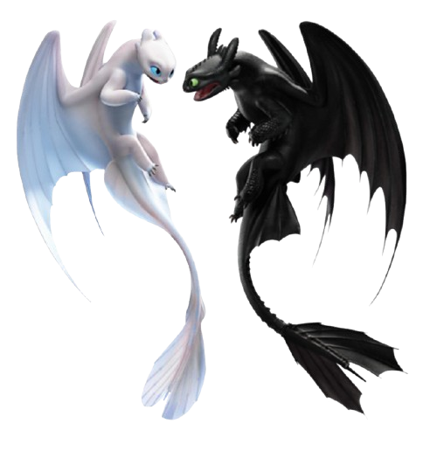
T O O T H L E S S
_______________
Dragoans
_______________

